Slide 1
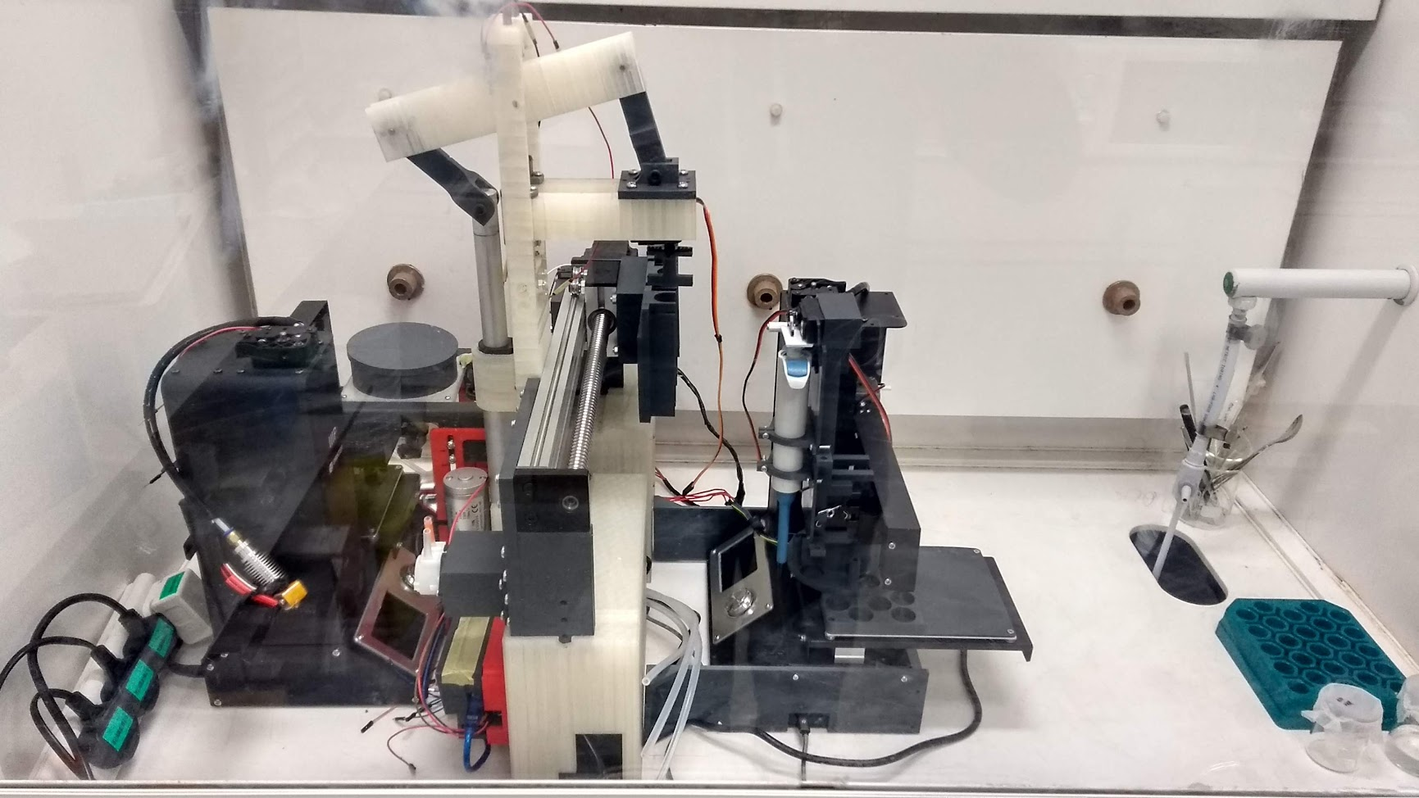
Old Machine
Filtering System
Dilution system
Reaction System

Slide 2
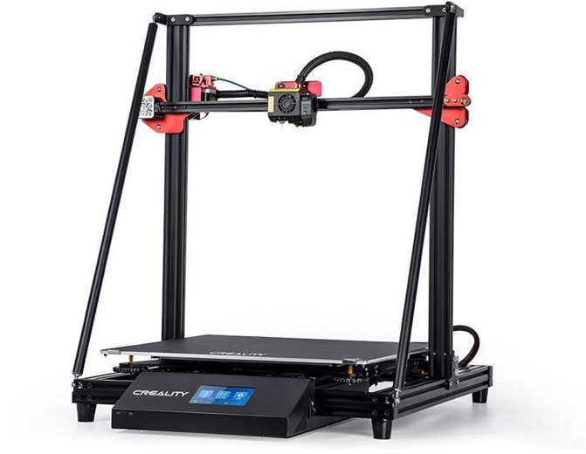
New Machine
Dilution system
Creality CR10-S Max Printer
  £550
  Large buildplate
  Dual screw z-axis for fast and high force z movement
Additional consumables
  Pipette tips
  Syringes
  Check valves
  Tubing
  Syringe filters
  Vials
  Mixing impellers (printable)
  Peristaltic Pumps
  Additional microcontroller (for external and head mounted systems)
Most budget can be spent at the start of the project through ordering necessary parts
  Some contingency budget needed to buy additional consumables as needs arise
Filtering System
Dilution system
Reaction System
Whole system in a single footprint greatly simplifies operation & maintenance

Slide 3
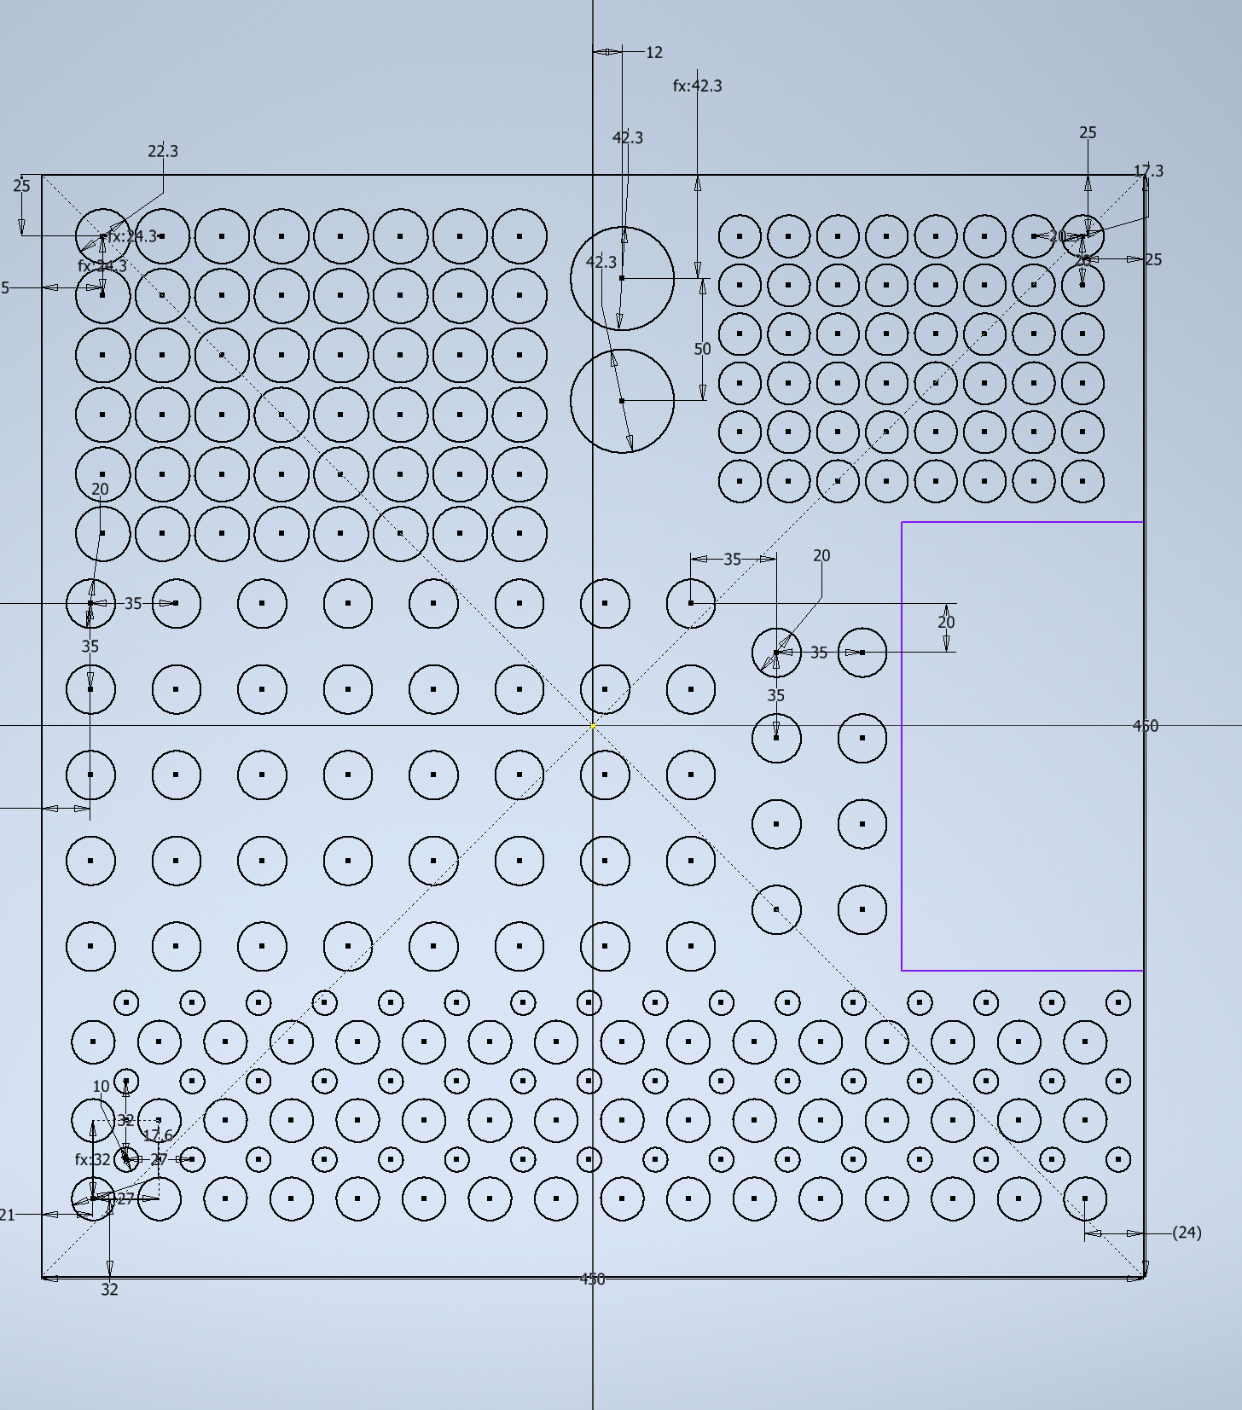
Plate Layout
Priming Bins
(acid & DES)
Mixing Vials
ICP Tubes
48 Samples on plate in this configuration
Pipette tips
Waste Area
Syringe
Collection Spouts
Syringes

Slide 4
Features
Long reactions with precise time information and event logging possible without supervision
Whole setup fits in a standard fume hood – scalable with no additional lab modifications required even when handling toxic samples
Self-building: since all of the components will be fitted within the machine print area – all parts of the machine can be printed by the printer before it is then modified for chemistry
Low cost & open source – development cost will be around £10K but finalised build cost should be significantly lower – all code can be published on an open repository and all parts used are widely available, so it can be modified and iterated by other uses as needed
Can handle and filter liquids with high viscosity and solid loadings (e.g. 10,000 cP, 25 v% particulate loadings)

Slide 5
Build Timeline
All funds can be spent by the project deadline (30th June) with a full design delivered
Machine probably won’t be operational until Jan ‘23 due to other work I need to complete for my PhD (experimental cycles using old machine) and inevitable problems in the building process
3 month verification period for new machine between Feb and April ’23
I will need external help from experienced engineers for CAD and build (since consumables take half the limit, the other half could be used to hire one?)

